Slide 1
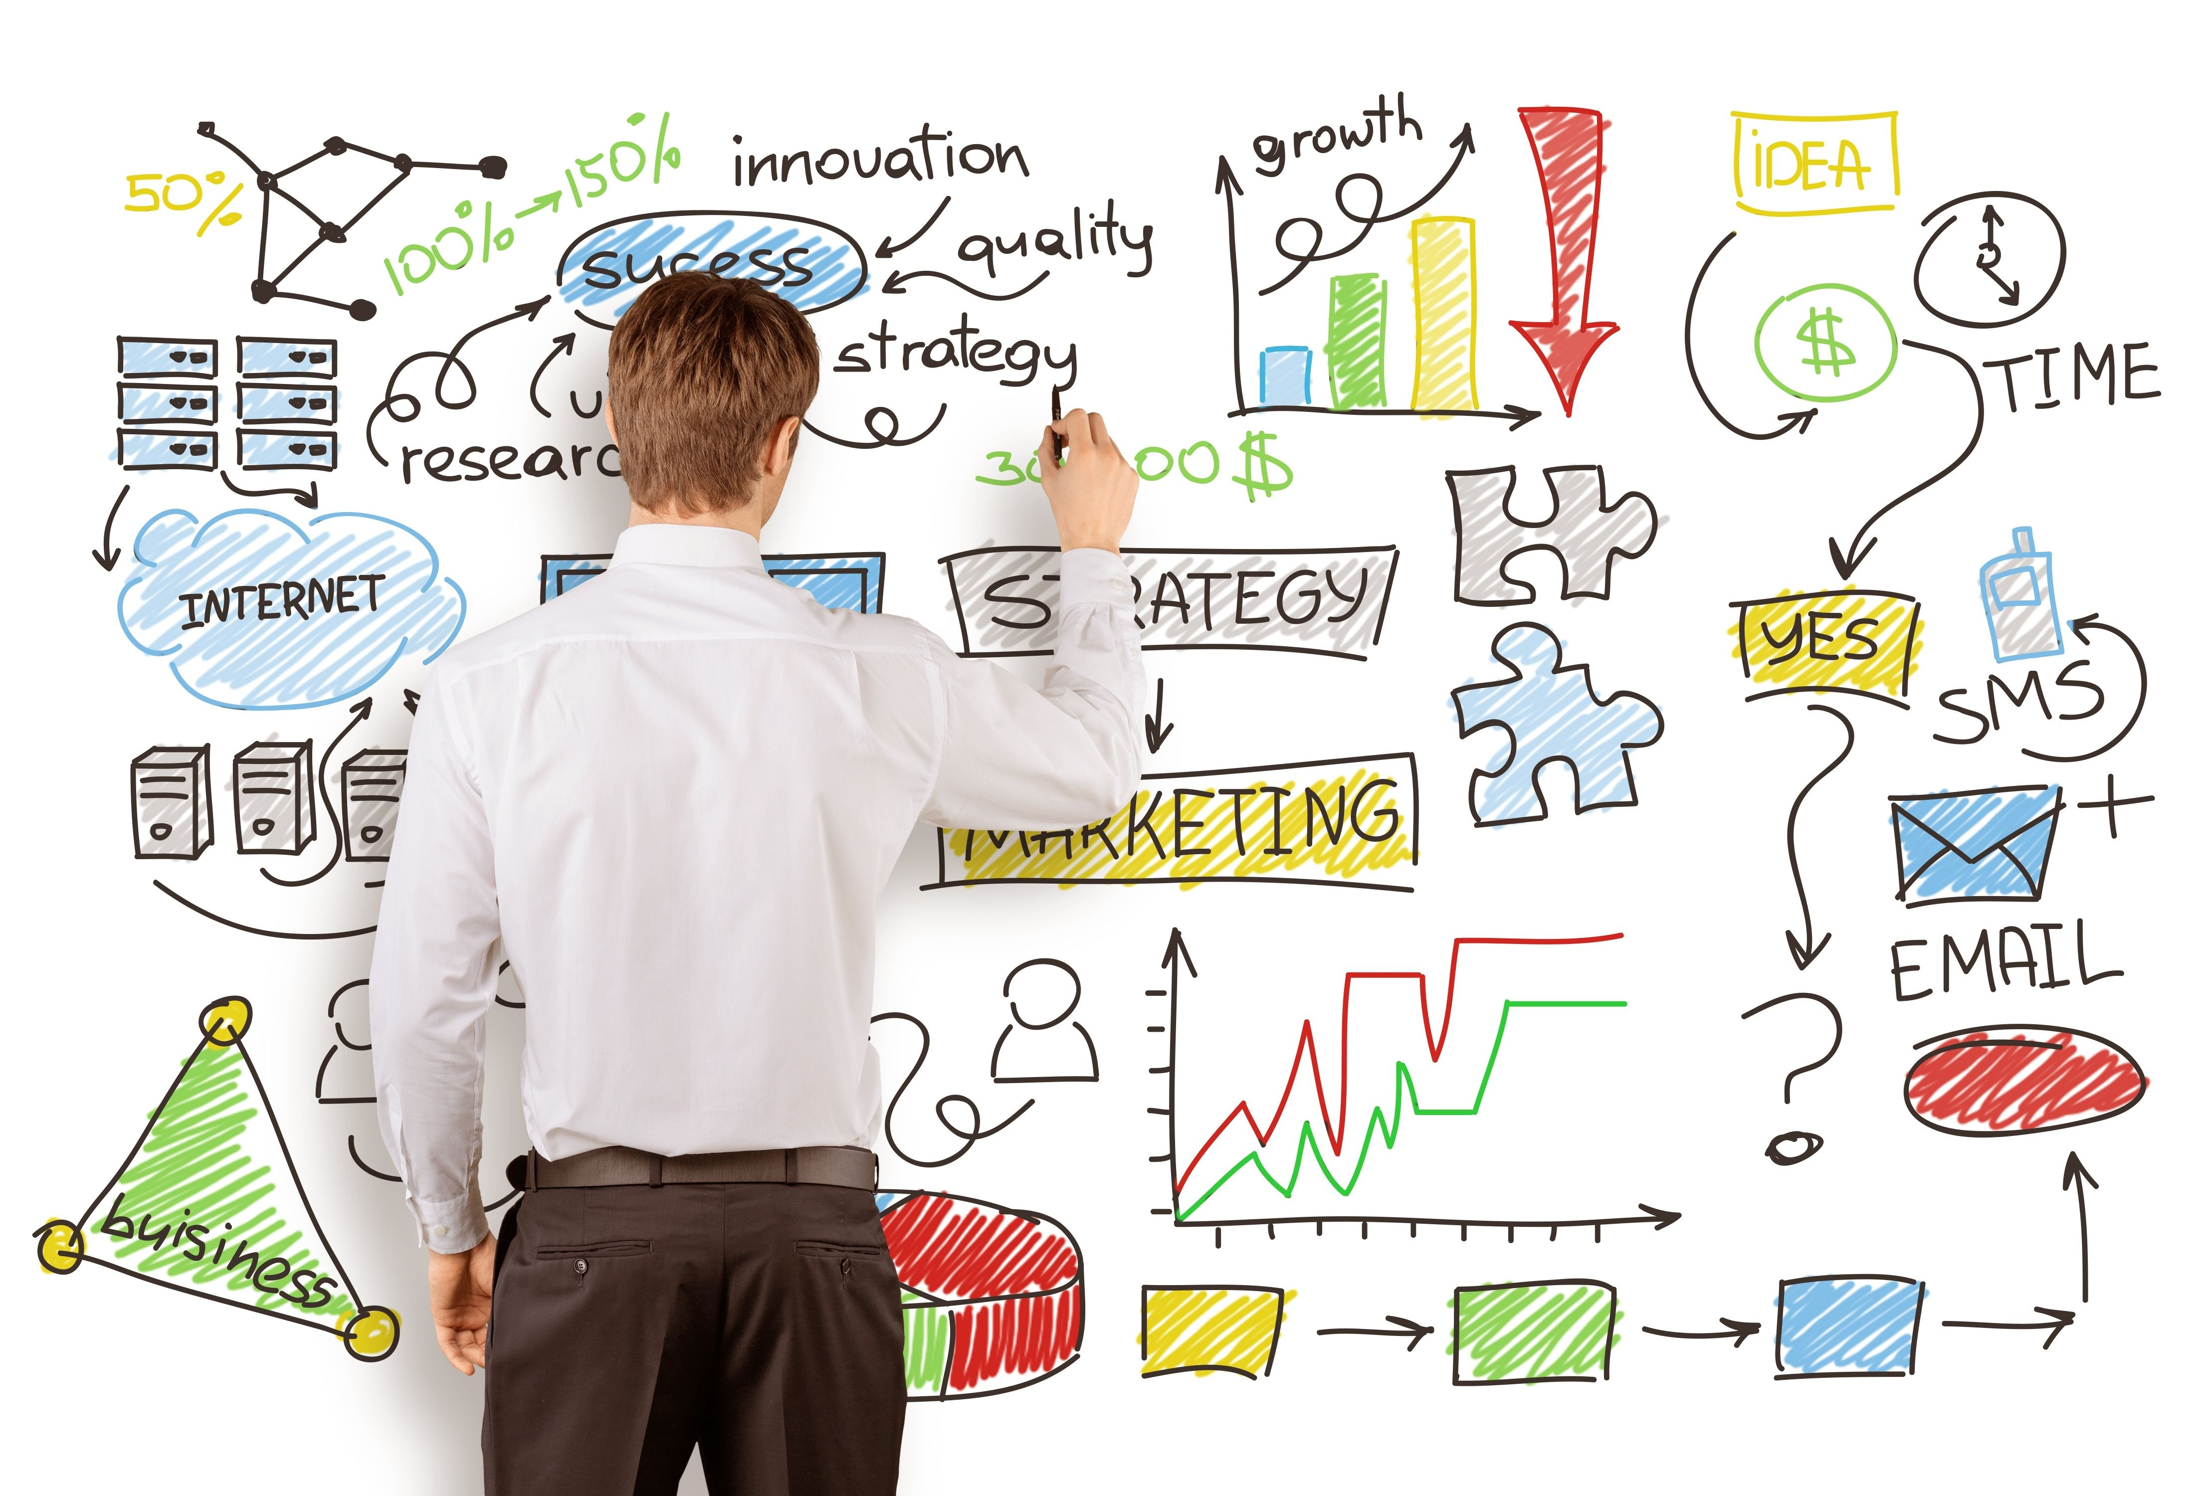
Unit 1

Slide 2
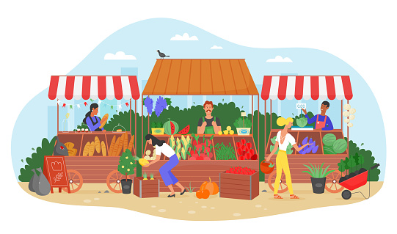
Market
“A place where business is conducted.”
Perreault and McCarthy -
Market is defined as a group of potential customers with similar needs or wants who are willing to exchange something of value with sellers offering various goods and/or services to satisfy those needs or wants.

Slide 3
Types of Markets
Consumer Market
Industrial/Business Market
Government Market / Non-profit Market
Global Market

Slide 4
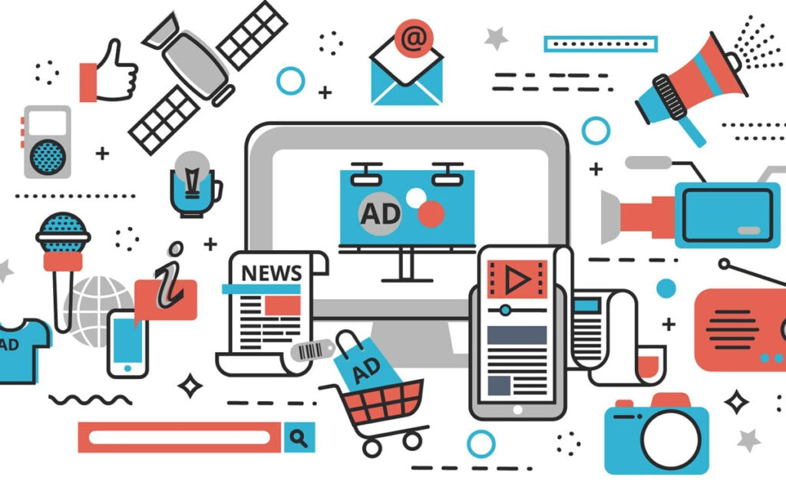
Marketing
Marketing is a societal process by which individuals and groups obtain what they need and want through creating, offering and freely exchanging products and services of value with others. —Philip Kotler
Marketing consists of the performance of business activities that direct the flow of goods and services from producers or suppliers to consumers or end-users. —American Marketing Association

Slide 5
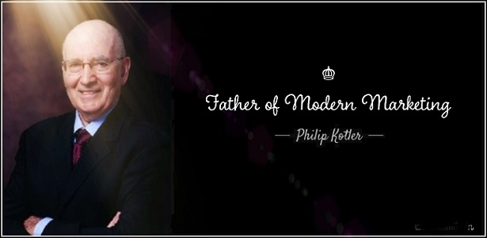

Slide 6

Nature of Marketing
Marketing Is an Economic function
Marketing is a legal process by which Ownership Transfers
Marketing ia a system of Interacting Business Activities
Marketing is a Managerial function
Marketing is a social process

Slide 7
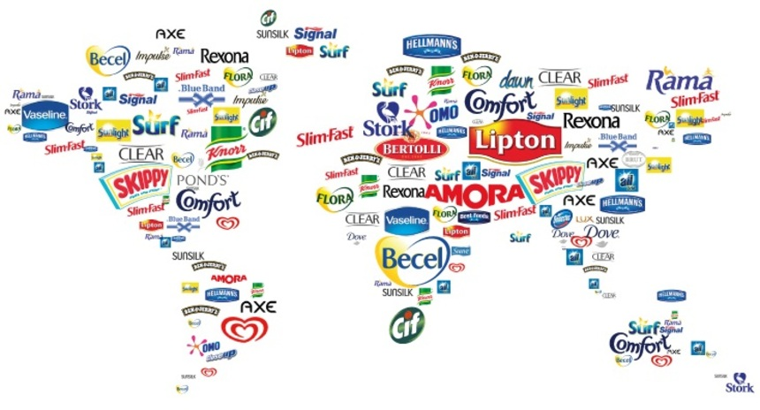
Scope of Marketing
Study of Consumer Wants and Needs
Study of Consumer Behavior
Production Planning and Development
Pricing Policies
Distribution
Promotion
Consumer Satisfaction
Marketing Control

Slide 8
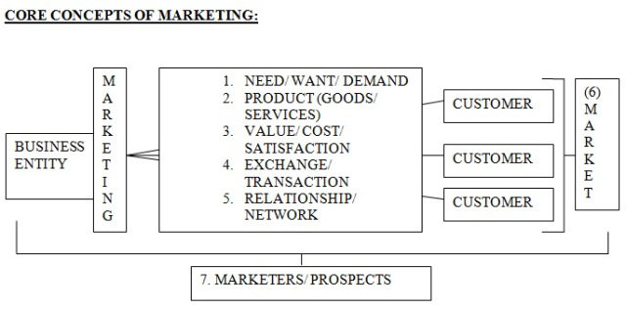
Core Concept of Marketing

Slide 9

I want it, I need it…..
5 Types of Needs
Stated needs- inexp.car
Real needs- less maintenance
Unstated needs- good dealer service
Delight needs- gifts from dealer
Secret needs – friends admiring

Slide 10

MARKETING MANAGEMENT
Marketing Management is the process of planning and executing the conception, pricing, promotion, and distribution of ideas, goods, services to create exchanges that satisfy individual and organizational goals.

Slide 11
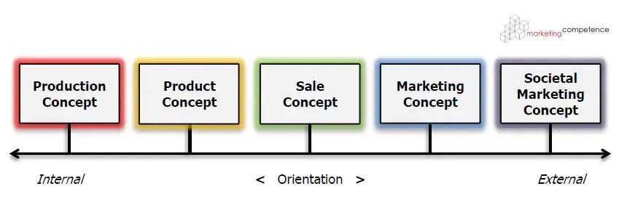
Types of Business Orientation

Slide 12
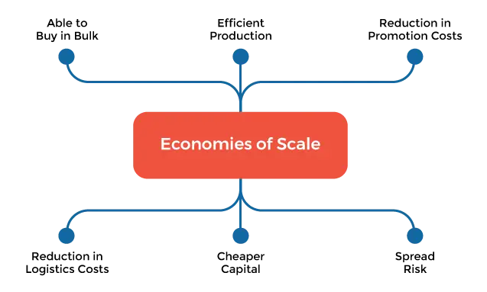
Production Orientation
Production-oriented companies focus on the production process and aim to manufacture goods as cheaply and quickly as possible.

Slide 13
Product Orientation
When a business takes a product orientation approach, it focuses on its product or service’s quality and performance. This sounds similar to the production approach, but the main difference lies in the customer’s involvement.
Customer satisfaction
Customer feedback from focus groups, surveys, polls, and other market research tools to better understand what the consumer wants
Developing new products to solve consumer needs

Slide 14
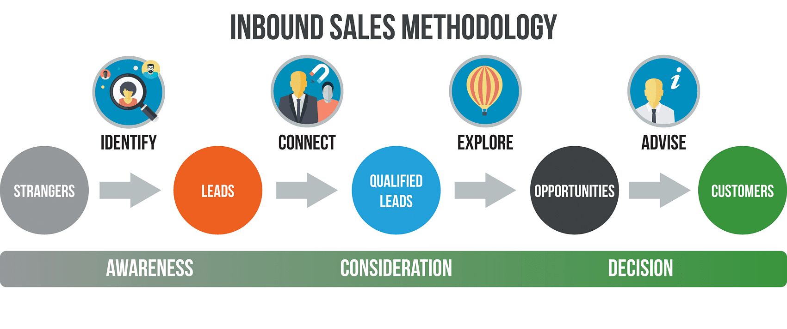
Sales Orientation
Sales orientation refers to a business strategy in which a company focuses on selling its products to potential customers in target markets. Typically, sales teams will use outbound sales tactics to promote products and drive revenue.

Slide 15
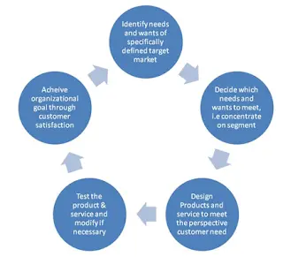
Market Orientation
This approach prioritizes identifying consumers’ needs and delivering products and services to satisfy them.

Slide 16
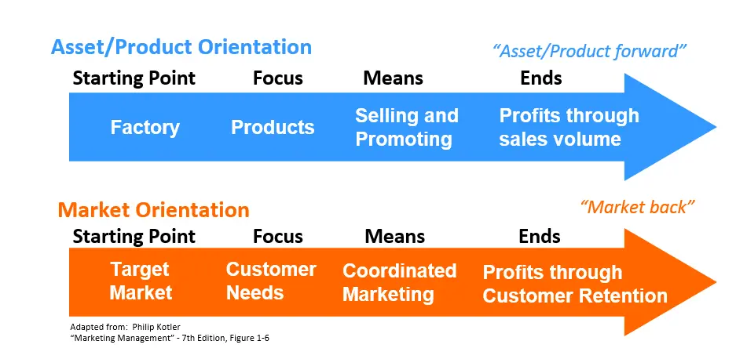
Selling Concept Vs Marketing Concept

Slide 17
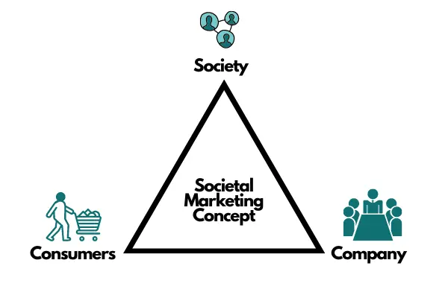
Societal Marketing Orientation
When a business uses this approach to inform their business strategies, they decide to put human welfare before profits and customer demands. This type of organisation emphasizes social responsibility, arguing that to achieve long-term success, their marketing strategy should provide value to customers and improve society’s wellbeing.

Slide 18
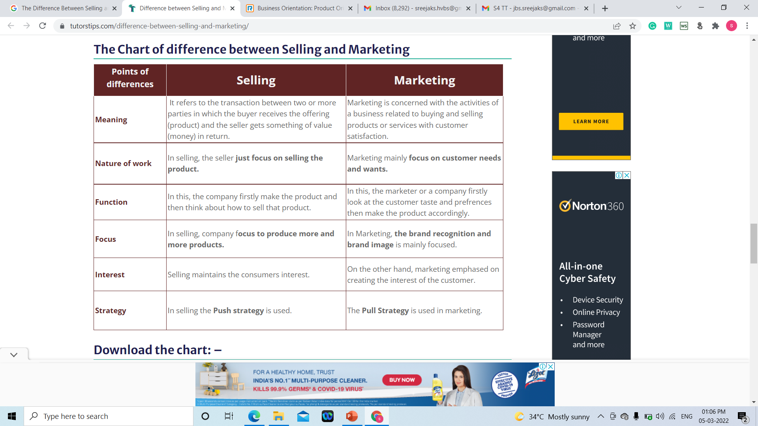
Difference between Selling and Marketing

Slide 19
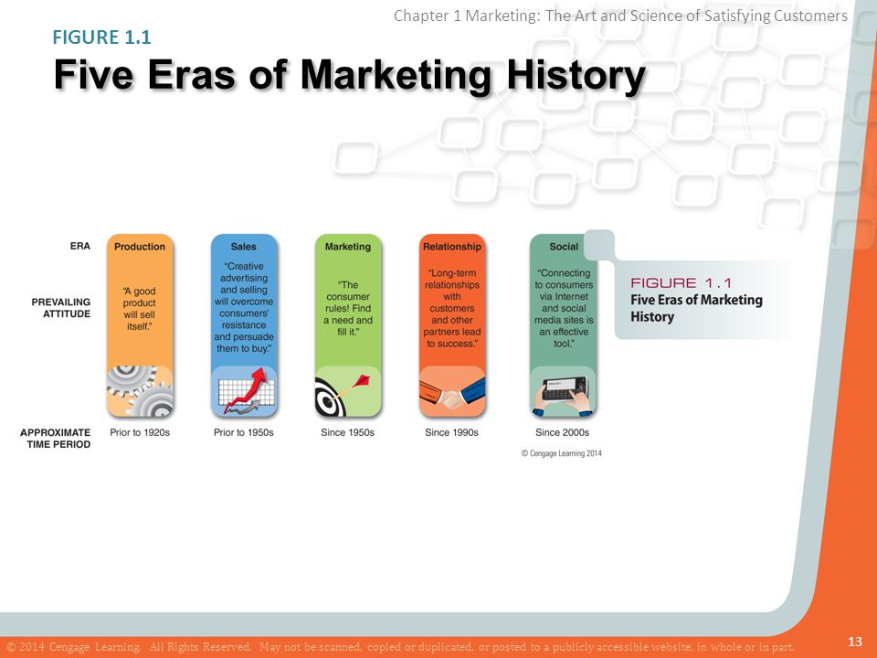

Slide 20
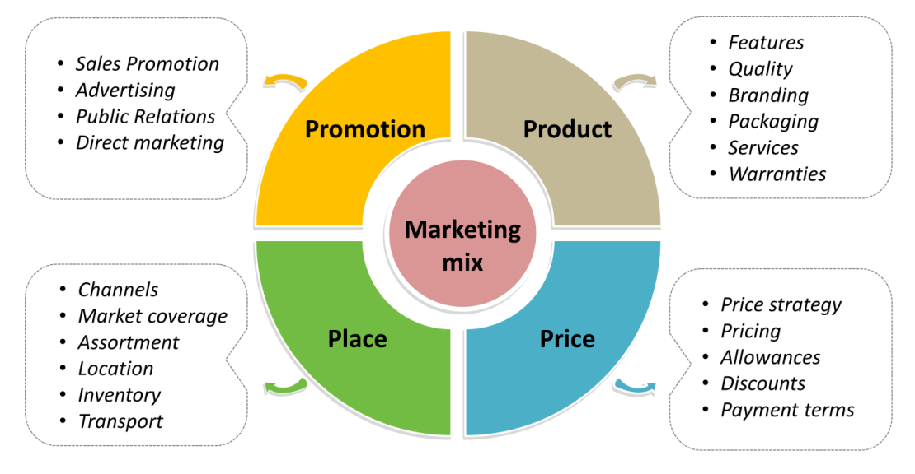
Marketing Mix

Slide 21

Extended 3 P’s
Physical Evidence
Process
People

Slide 22
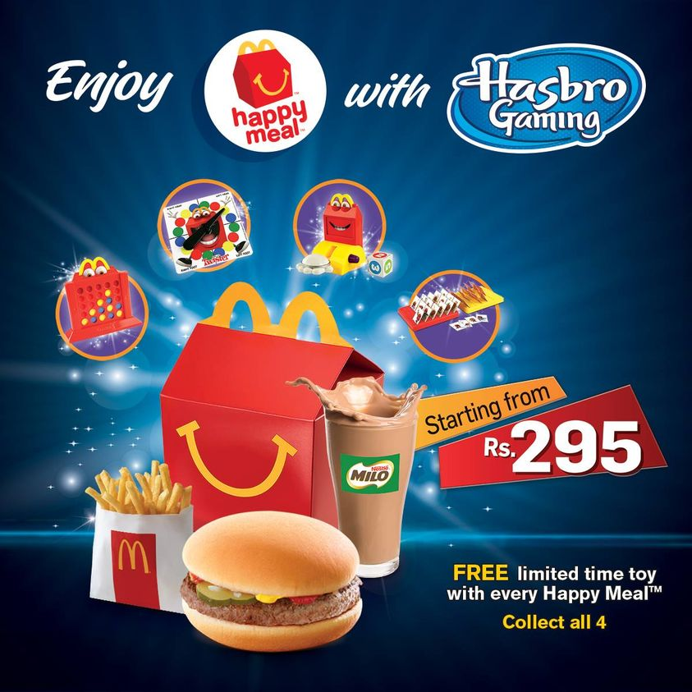
Ilustration Of 7 P’s(Example) : Mc Donalds
Product : Burger, French Fries, Salads, Desserts & Chicken
Price : Happy Meal
- Cost Based & Competition –based pricing.
Promotion : Advertising
(TV Commercials), Sales
Promotion (Coupons, Happy
meals etc…

Slide 23

Place – Branches are evenly spread out all over the country. It offers delivery services and drive – through services ( Manufacturer – Retailer – Consumers)
People – The employee in Mc Donalds have a standard uniform & Mc Donalds specially focuses on friendly and prompt service to its customers from their employees.

Slide 24
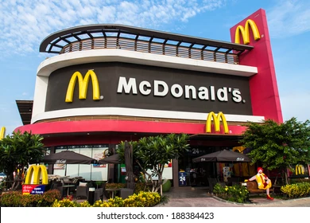
Process – The food manufacturing process at Mc Donalds is completely transparent (the whole process is visible to the customers).
Physical Evidence- Mc Donalds focuses on clean and hygienic interiors of its outlets and at the same time the interiors are attractive .

Slide 25
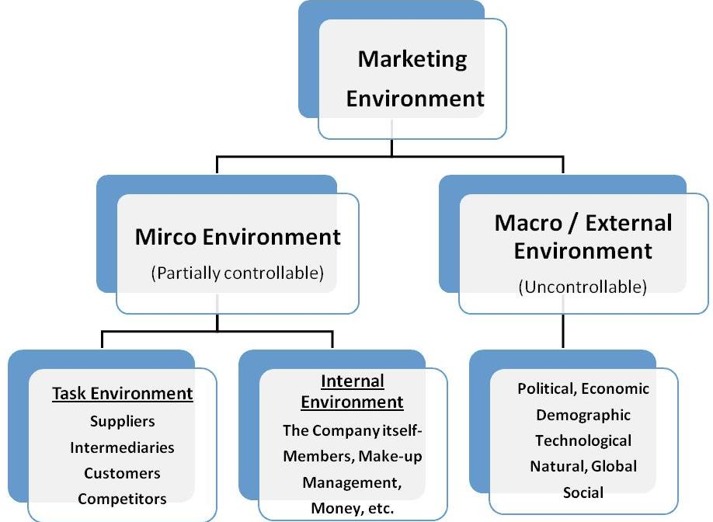

Slide 26
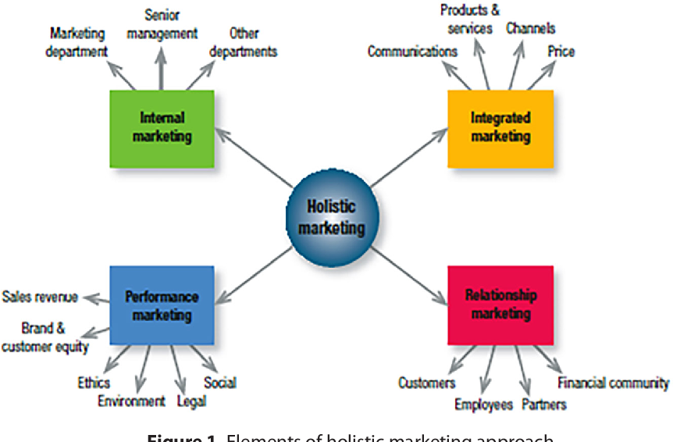

Slide 27

Marketing Information System
Cundiff, Still and Govoni define MIS as, “Marketing information system is an organised set of procedures, information handling routines and reporting techniques designed to provide the information required for making marketing decision.”
Professor Alder Lee opines “Marketing information system is an interacting, continuing, future oriented structure of people, equipment and procedure designed to generate and process an information flow which can aid business executives in the management of their marketing programmes.”

Slide 28

Marketing Information System – Importance
Anticipation of Consumer Demand
Complexity of Marketing
Significance of Economic Indicators
Significance of Competition

Slide 29
Cont..,
Development of Science and Technology
Consumerism
Marketing Planning

Slide 30

Big Data Analytics
Big Data Analytics technologies and techniques give organizations a way to analyze data sets and gather new information. Business intelligence (BI) queries answer basic questions about business operations and performance.
Organizations can use big data analytics systems and software to make data-driven decisions that can improve business-related outcomes.
The benefits may include more effective marketing, new revenue opportunities, customer personalization and improved operational efficiency.
With an effective strategy, these benefits can provide competitive advantages over rivals.

Slide 31
Big Data Concepts Analytics Important
Reduced cost
Quick decision making
New products and features

